Slide 1

Digital portfolio
STUDENT :YOGALAKSHMI.P
REGISTER NO : 36324u18077
Department : bsc (Computer science )
College : sree abiraami arts and science college for women
University : thiruvalluvar university
Email id. : yogalakshmi6002@gmail.com

Slide 2

Project tittle
Problem statement
Project overview
End users
Tools and technologies
Portfolio designs and layout
Feature and functionality
Results and screen shot
Conclusion
GitHub link

Slide 3

Problem statement
Traditional resumes and paper portfolios cannot fully show a person’s skills and talents. A digital portfolio is needed to clearly present achievements, projects, and abilities in an easy and professional way.

Slide 4
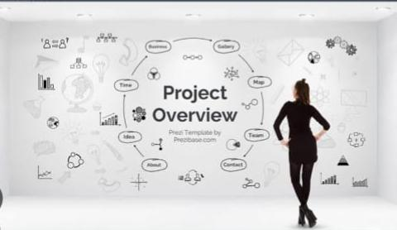
Project overview
Project Overview: Digital portfolio
digital portfolio is an online collection of an individual’s skills
Achievement, experiences, and work samples presented in a professional and creative manner.
This project focuses on developing a personal digital portfolio
That can be used for academic, professional, and career-building purposes.

Slide 5

End users
1. Students themselves – to reflect on their own learning, growth, and achievements. 2. Teachers / Mentors – to evaluate student learning, progress, and skills. 3. Employers / Recruiters – to assess job applicants’ skills, creativity, and real-world work samples. 4. College / University Admissions Officers – to check applicants’ projects, extracurricular, and academic achievements.

Slide 6
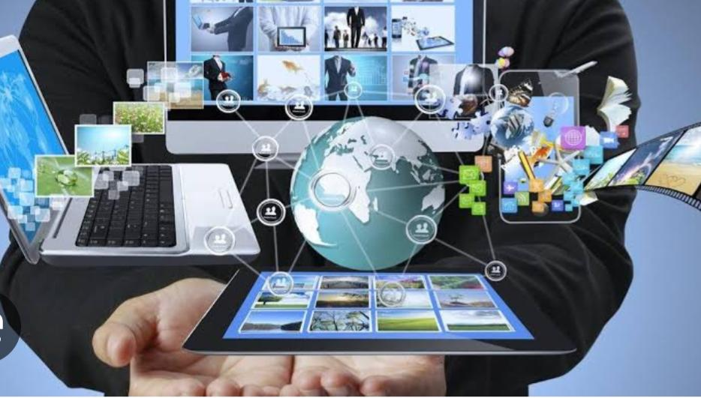
Tools and technologies
1.Website Builders 🖥️
Tools: Wix , WordPress, Google Sites (Helps you create your personal website without coding.)
2. Design Tools 🎨
Tools: Canva, Figma, Adobe XD (used for creating attractive resumes, graphics, and layouts.)
3. Document Tools 📄
Tools: MS Word, Google Docs, La Tex (For writing resumes, reports, and personal statement)

Slide 7
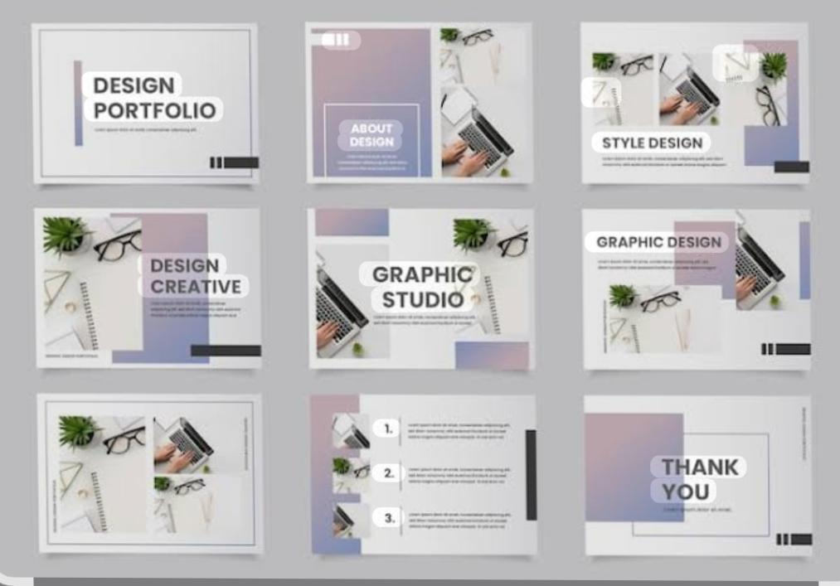
Portfolio designs and layout
1. Single Page Scroll Layout
(About Me → Skills → Projects → Contact).
Clean and minimal, easy to navigate.
2. Grid Layout
Uses boxes/cards to showcase projects.
Each card has a picture, title, and short description.
Example: photo gallery style.
3. Two-Column Layout
Left side → profile picture, bio, skills.
Right side → projects, certificates, achievements

Slide 8

Future and functionality digital portfolio
Future of Digital Portfolio
More people will use digital portfolios instead of paper resumes
Can include videos, images, and interactive content.
Functionality of Digital Portfolio
Show skills, projects, and achievements in one place.
Helps in jobs, education, and personal branding.

Slide 9
Results and screenshot
About me
I am P. Yogalakshmi, a B.Sc. Computer Science student. I am passionate about learning new technologies and improving my skills in the field of computer science. I am a positive, hardworking, and motivated person
Skills
C++
HTML
CSS
Python
Certificate
Add on course and advertising strategy
Government of tamilnadu Department of technical education junior Certificate
Cloud computing Certificate
Web development certificate
Overview of English communication lanquil Level cerificate

Slide 10
GitHub link
Project link
GitHub link
https://yogalakshmi2911.github.io/yogalakshmi-portfolio/
https://github.com/yogalakshmi2911

Slide 11
Conclusion
A digital portfolio is an effective way to showcase skills, knowledge, and achievements in an organized manner. It highlights both academic and personal growth while providing evidence of creativity and technical abilities. With its easy accessibility and professional presentation, a digital portfolio not only helps in self-reflection but also creates opportunities for higher studies, career development, and personal branding.

Slide 12

Thank you !
🌸 Thank You for visiting my digital portfolio. Your time and support mean a lot to me.

